Slide 1
Welcome
To the presentation of Team Infinity

Slide 2
Project - Calculator
Submitted by -
Md Rasel Uddin
Md Sabbir Hossain
Md Nazmul Hasan Fahim
Aungkita Barua
Ahnaf Tahmid Hasan
Submitted To -
Md. Shadman Sakib
Lecturer,
M.Sc.(Engg.) in CSE, MBSTU (Ongoing)
B.Sc.(Engg.) in CSE, MBSTU

Slide 3

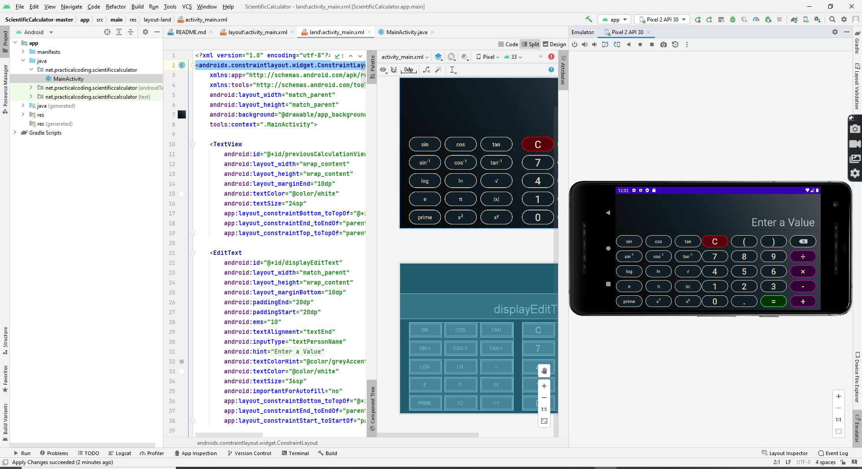
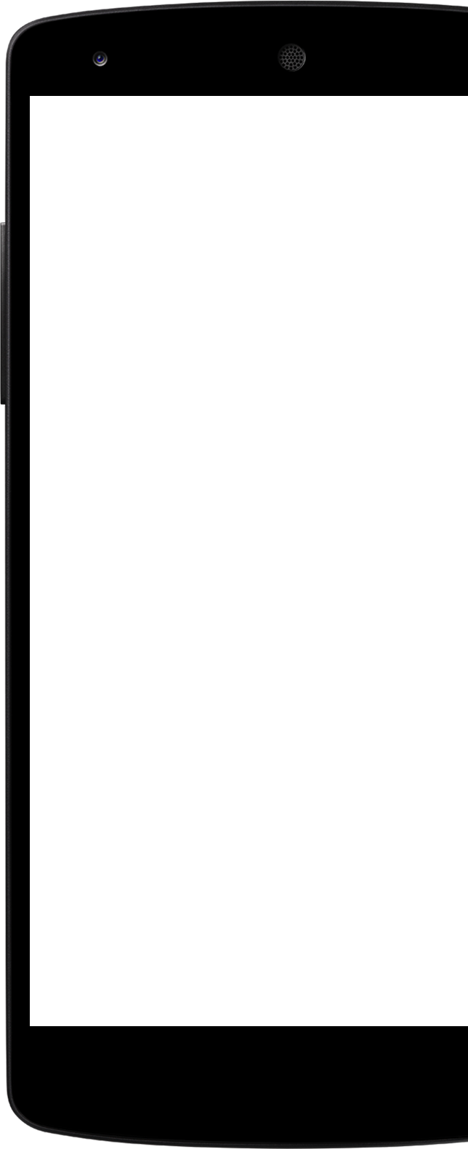
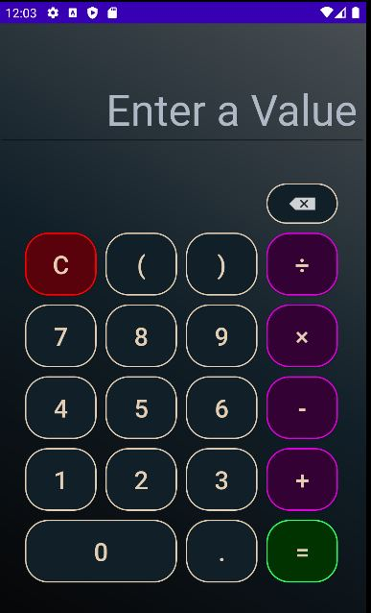
Project Calculator
User-friendly User Interface and unique
Calculator.

Slide 4
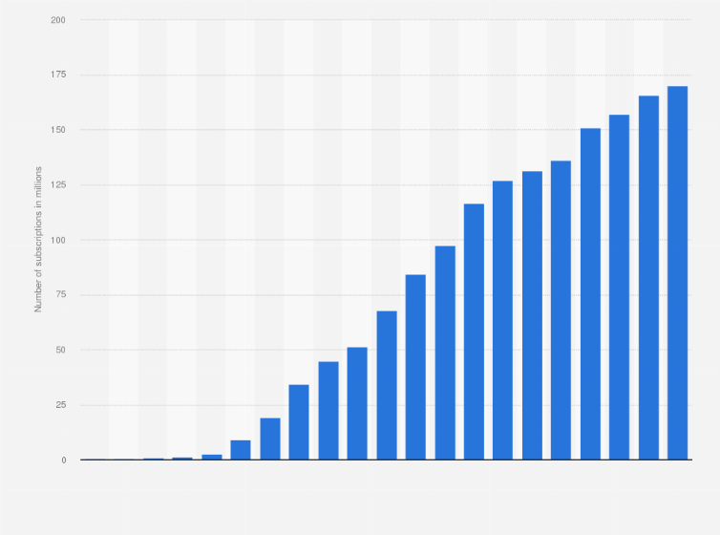
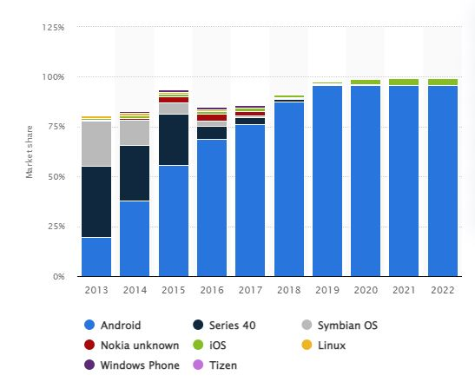
Introduction and Motivation
Mobile phone user 2000-2020
In 2020, 170.14 million
62% of them are smartphone users[3]
Around 95.66% are android users [2].
People are lazy-favoured
All in one
Number of mobile phone users in Bangladesh [1][2]

Slide 5


Motivation:
Malicious object free
No promotion ad
Error free
Free of hacking risk
Plus user-friendly
Multi-featured

Slide 6

Objective
Providing a malicious free app
Most user-friendly and attractive designing app
100% Ad Free. Showing no ad at all.
Both normal and scientific features available
Raw code. No third party materials.
In a word, providing user a trusted calculator app

Slide 7
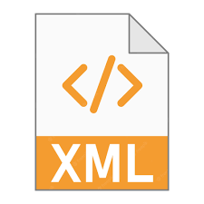


Tools used :
Android Studio Software
Virtual Emulator
Java SDK
XML Front-end (Designs)
Java Backend (Functions)
Smartphone (android) User Experience

Slide 8
Feature of the Project Calculator
Normal basics Calculation
+
-
X
/
Scientific calculation
sin()
cos()
tan()
Sin inverse 1
Cos inverse 1
Tan inverse 1
log
Ln
√
e
π
|x|
prime()
X2
X power y
Most User-friendly
Edit Numbers in position
Nice Interface
Easily understand any key in keypad
If you rotate, a scientific interface will appear

Slide 9
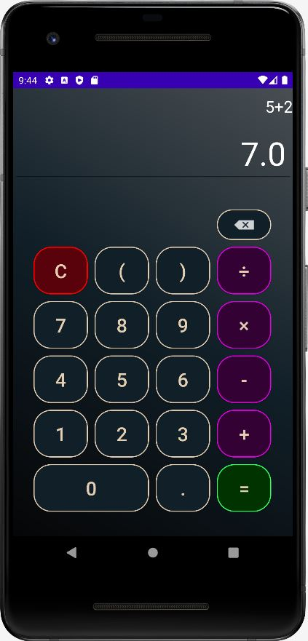
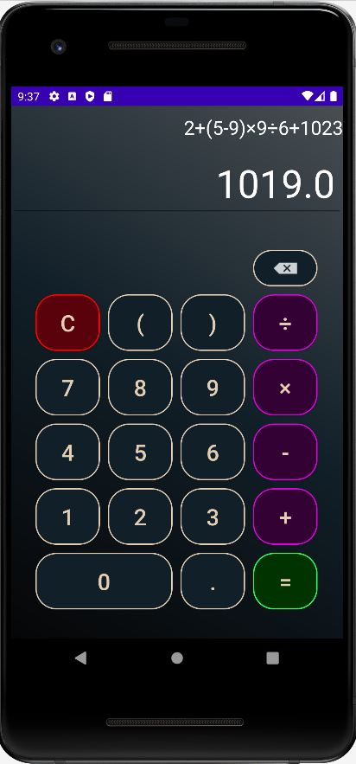
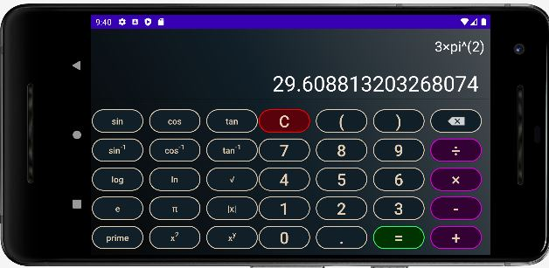
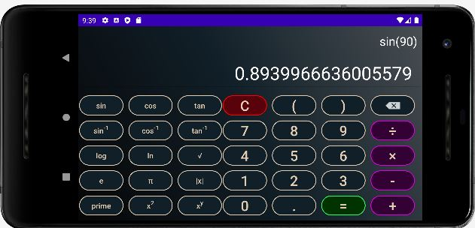

Slide 10
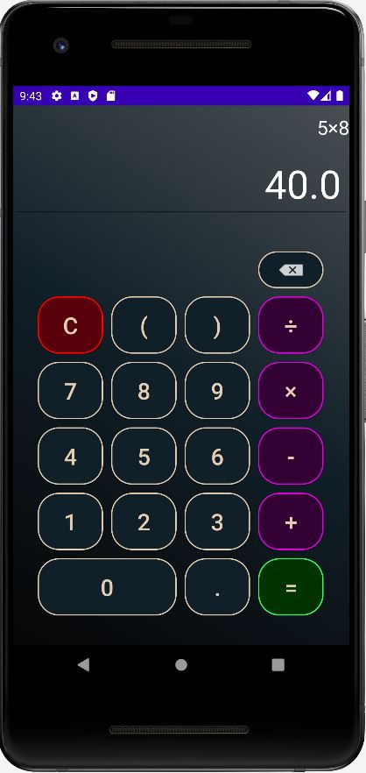
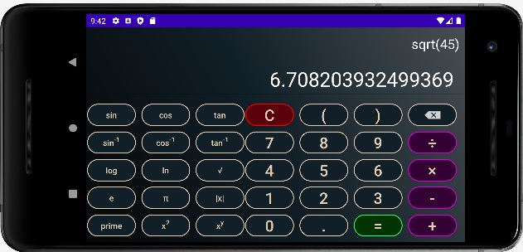

Slide 11
Functions of Our CalC app:

Slide 12
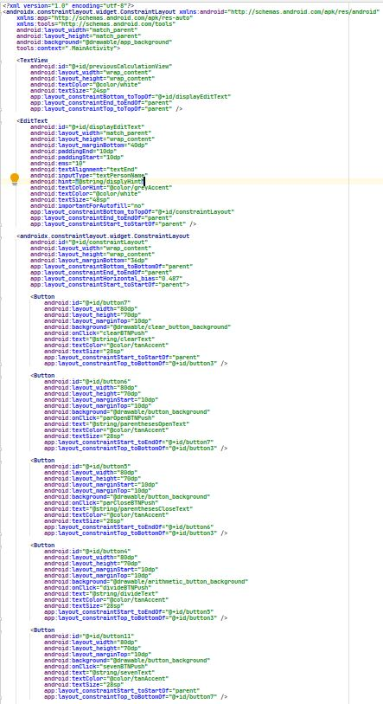
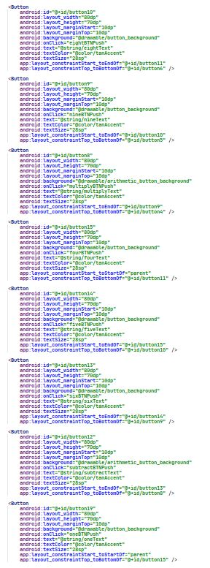
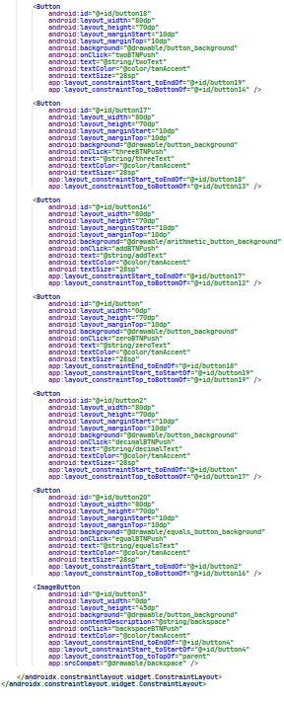
Front-End

Slide 13
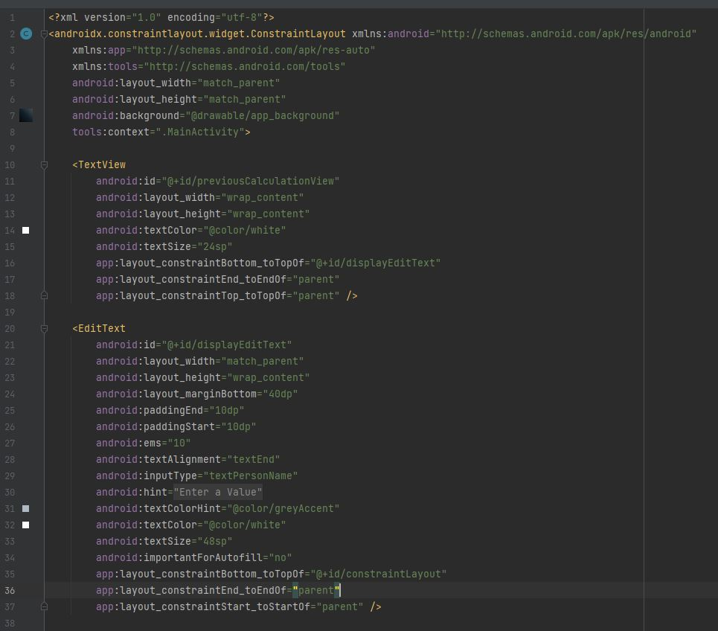
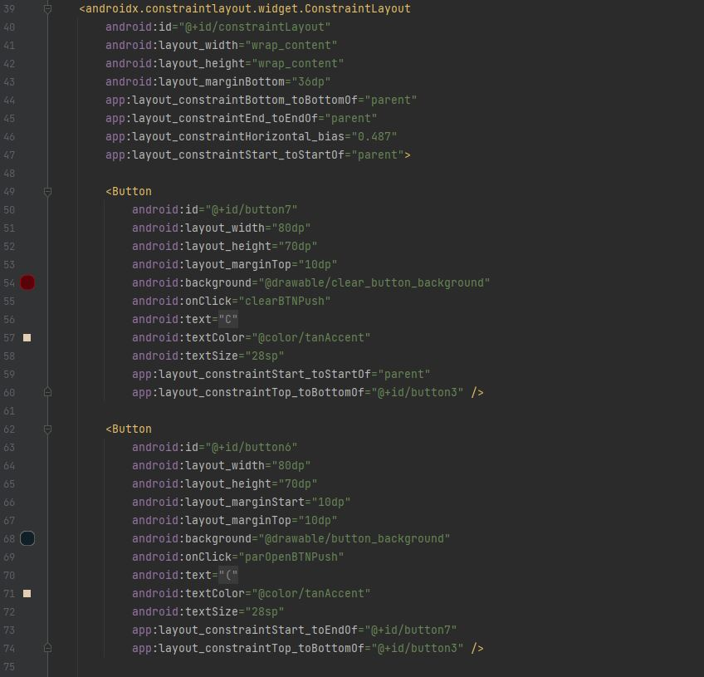

Slide 14
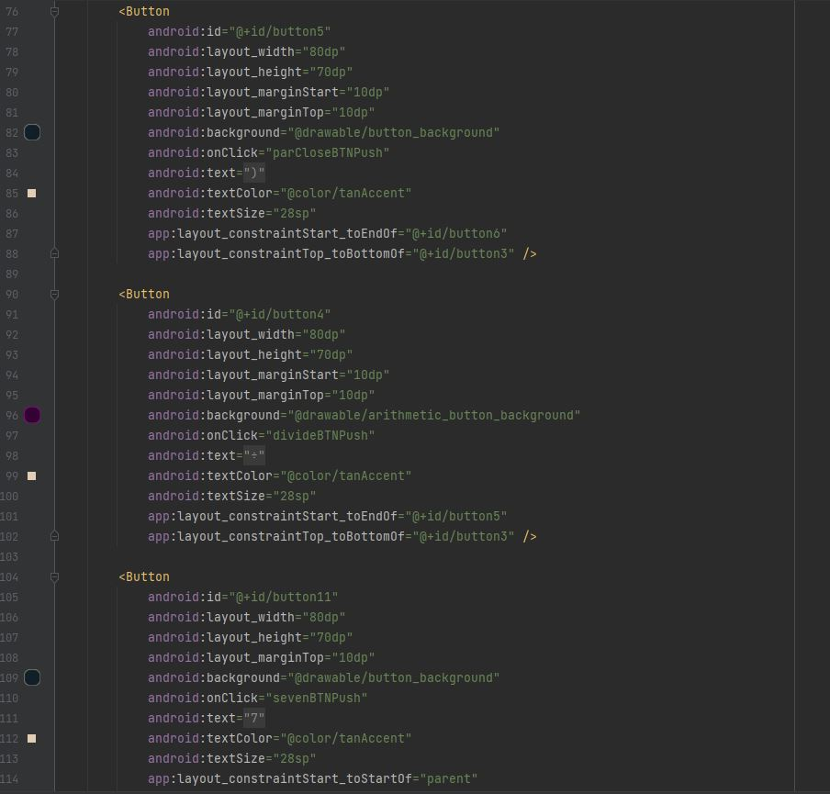
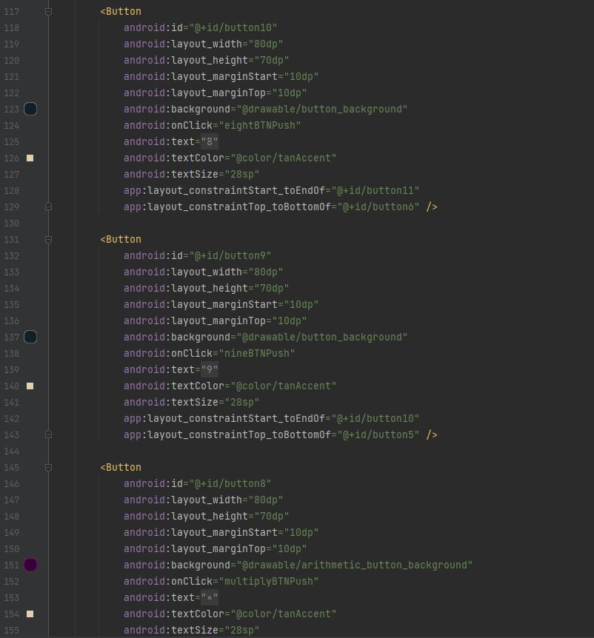

Slide 15
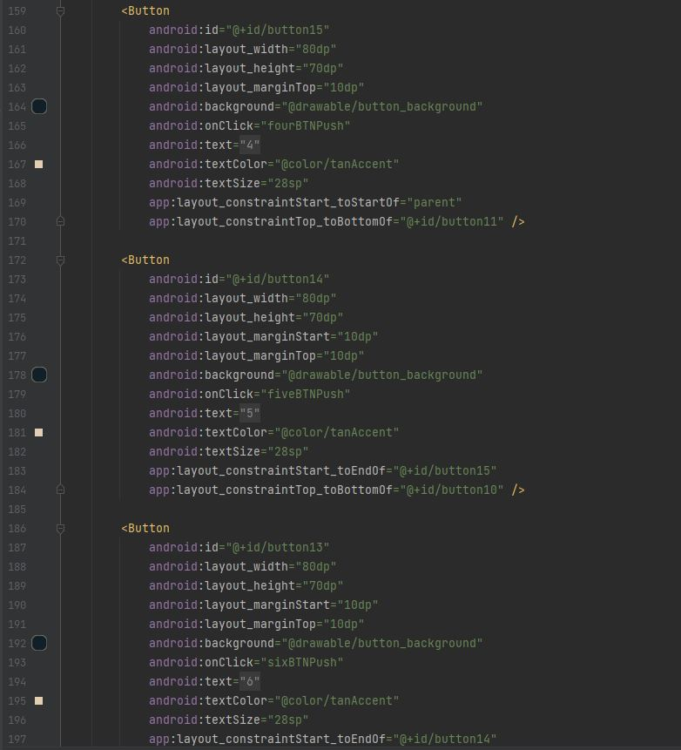
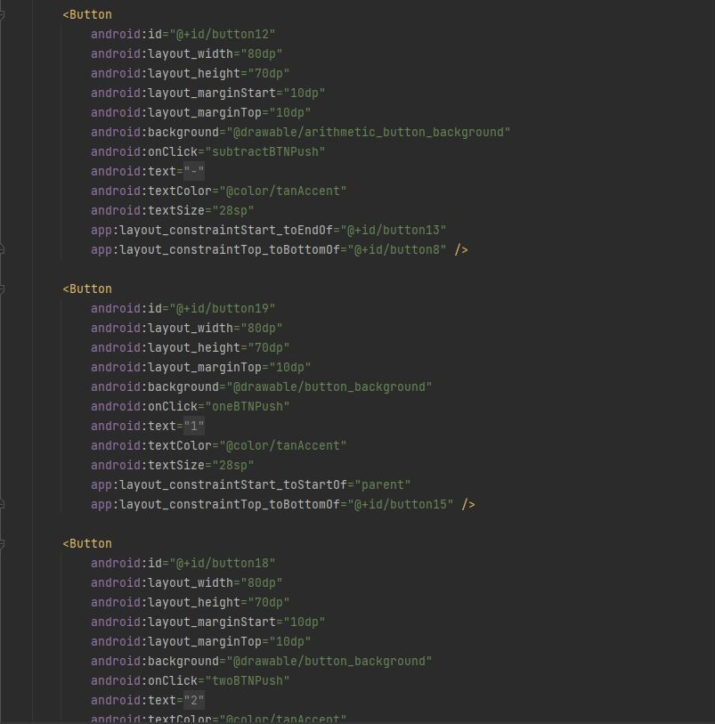

Slide 16
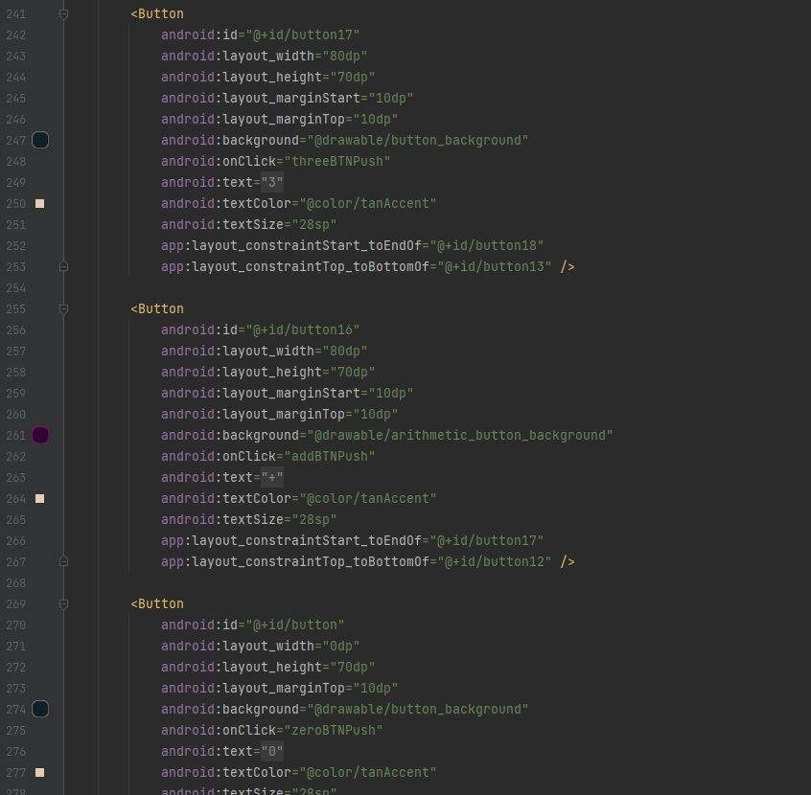
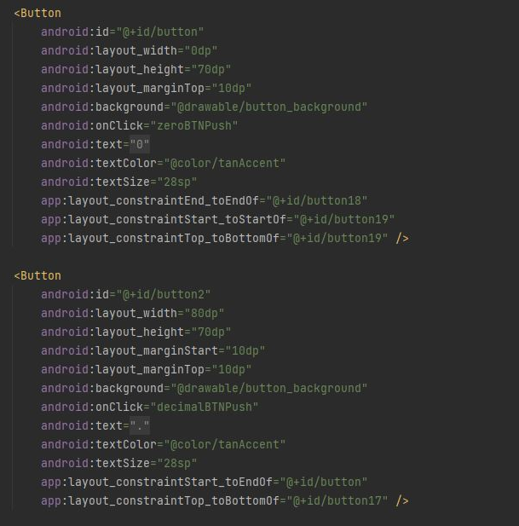

Slide 17
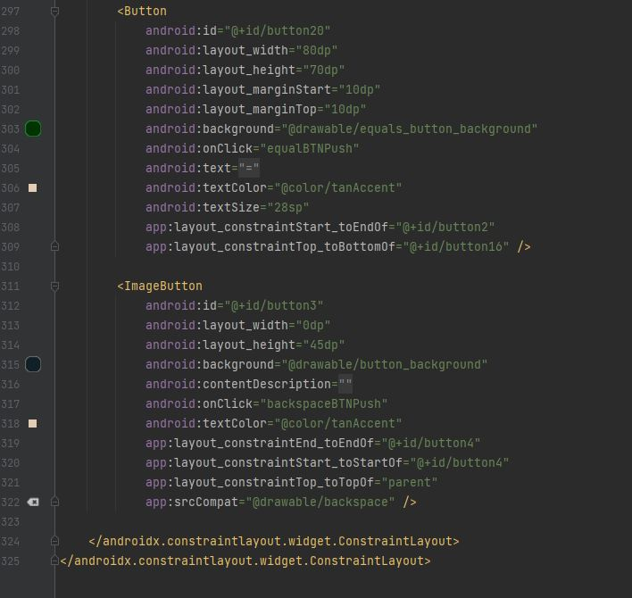

Slide 18
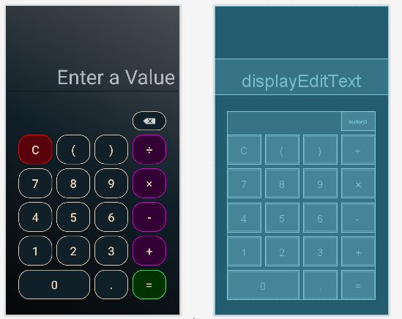
Design from above code:

Slide 19
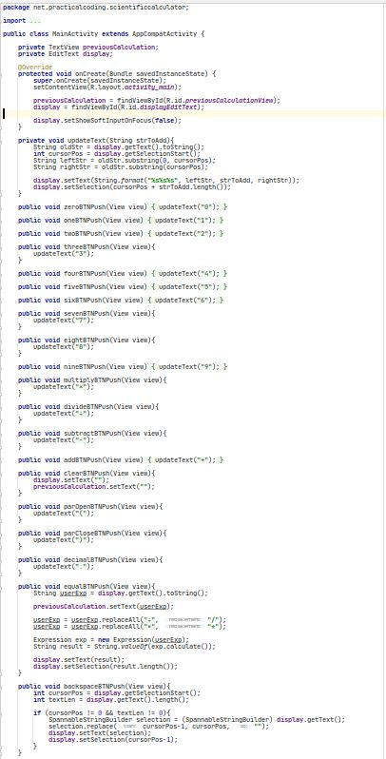
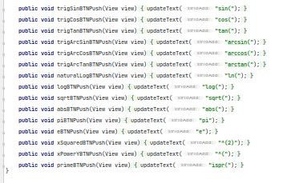
Back-End

Slide 20
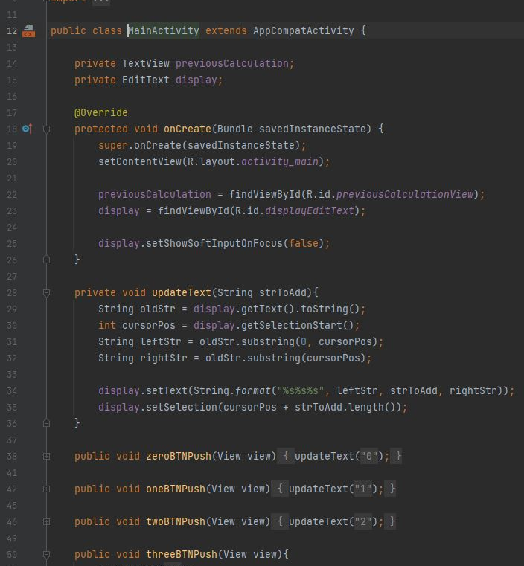
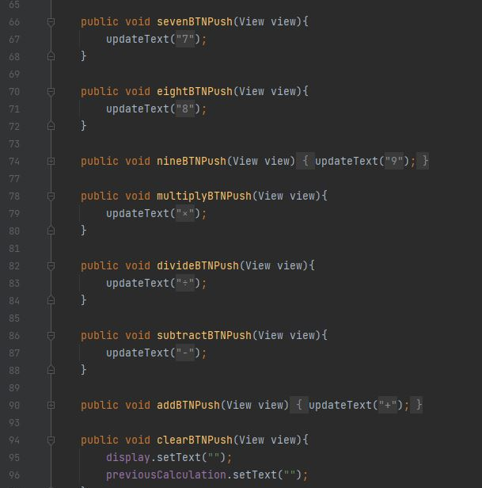

Slide 21
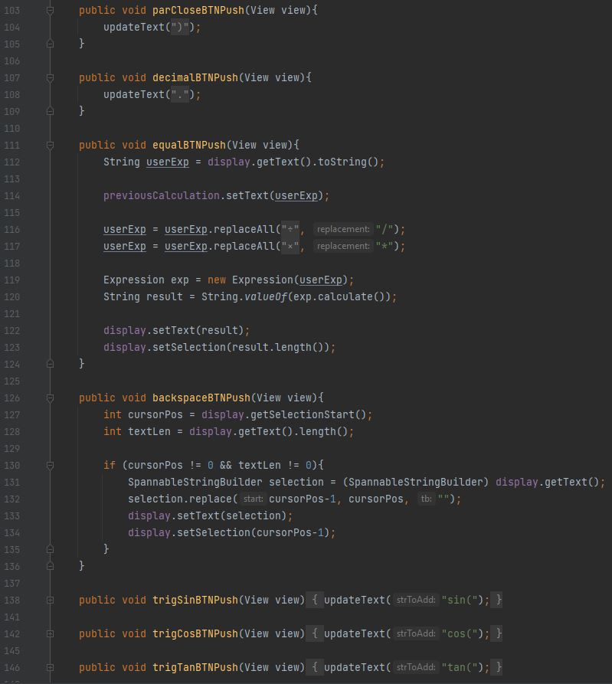
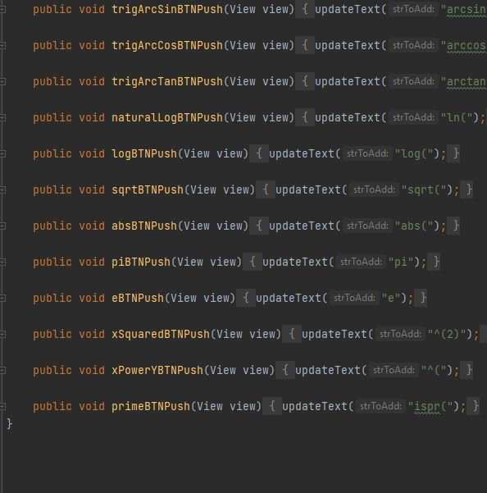

Slide 22
Limitation
Limited features

Slide 23
Future Work
Vision of implementation of “All in One”.
Adding more feature such as
Saving calculation history in Google Drive
Voice generated key typing for blind people
More advanced scientific calculations availability
etc.
Automatic calculation of other tasks
Measurement of land
Salary calculation
Etc.
Etc. as far as future requirements

Slide 24
Conclusion
Achievement
A fantastic android app
features
User benefits
Malicious free
User-friendly
Development of Existing
Make it dynamic

Slide 25
Reference:
https://www.statista.com/statistics/497091/number-of-mobile-cellular-subscriptions-in-bangladesh/#:~:text=Number%20of%20cellular%20subscriptions%20Bangladesh%202000%2D2020&text=In%202020%2C%20the%20number%20of,Bangladesh%20was%20at%20170.14%20million.
https://www.statista.com/statistics/528256/mobile-operating-system-share-in-pakistan/
https://www.tbsnews.net/tech/62-bangladeshi-users-have-smartphones-2025-report-294121

Slide 26
Thank You

